Slide 1
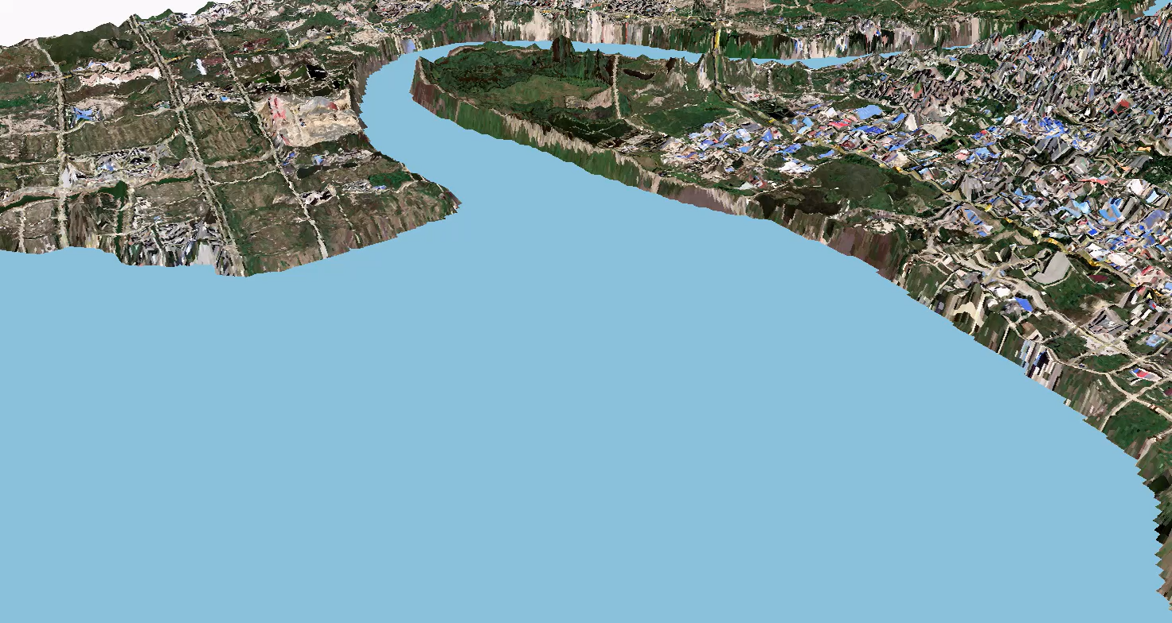
3D simulation map of seawater intrusion in Yingkou

Slide 2
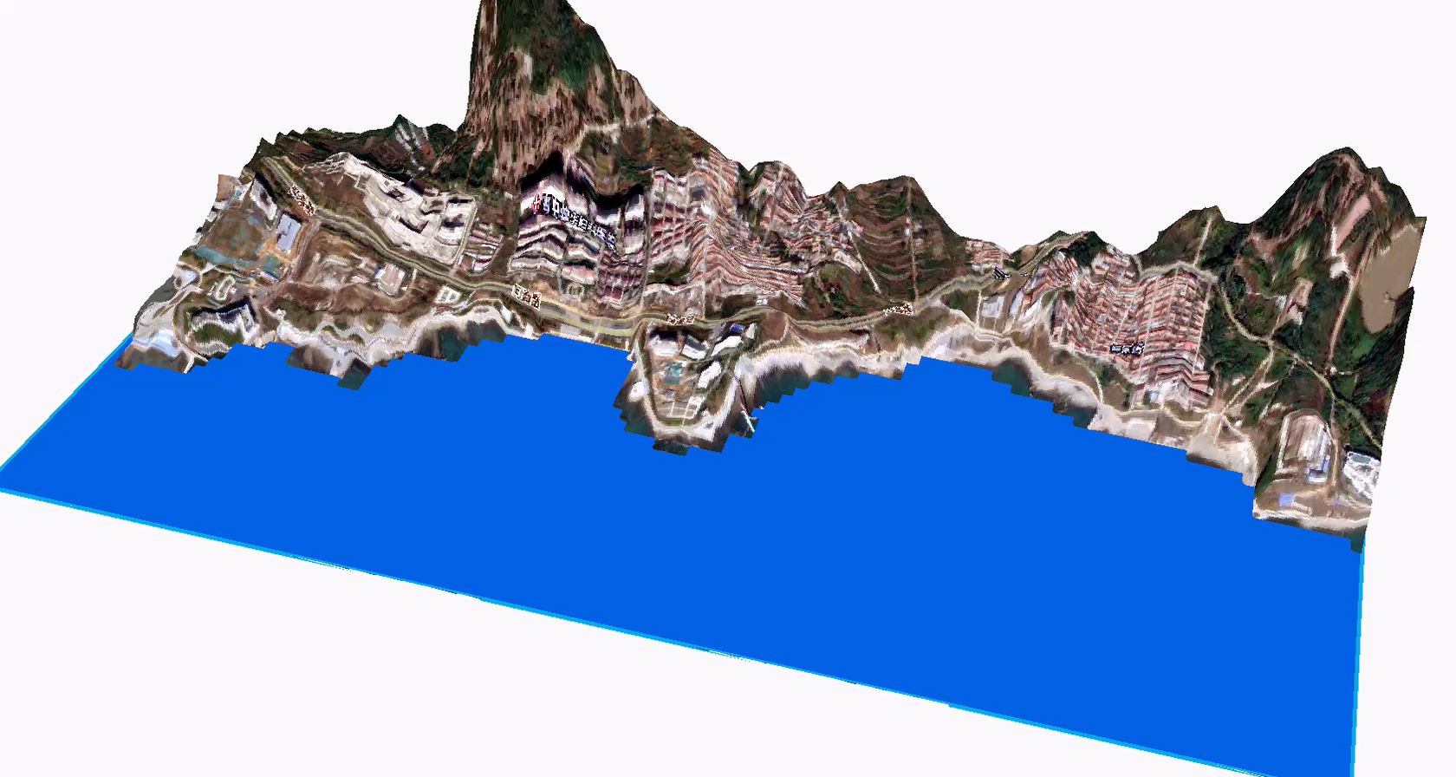
3D simulation map of seawater intrusion in a certain area of Qingdao

